Slide 1
Team Epsilon
Team Members:
∙ Thomas Zachry ∙ Diane Chin ∙ Randy Thien Cao ∙ Charlie Pan ∙ Shayan Raza

Slide 2
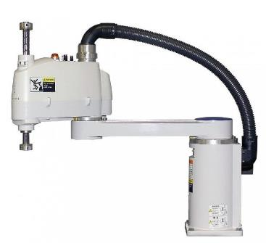
Project :
Scara Robot

Slide 3
Sprint goals
Progress on Project Charter
Research existing SCARAs
Skeletal Design Planning
Decide on what hardware components to use
Version Control Setup and Configuration
GitHub

Slide 4
PROGRESS
Project Charter Complete
Skeletal configuration research in Progress
Material Selection
Design Process
Version Control Setup Complete
GitHub
Organization App (LeanKit)

Slide 5
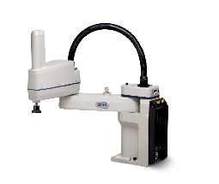
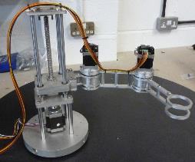
Existing Designs
2 – Segment SCARA:
Accurate
Less Coverage
3 – Segment SCARA:
Less Accurate
More Coverage

Slide 6
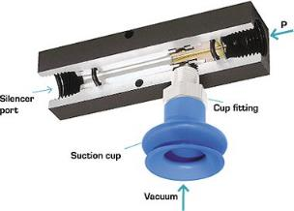
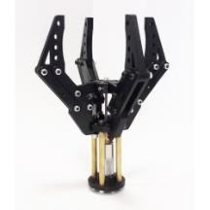
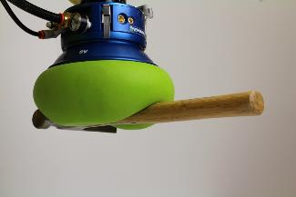
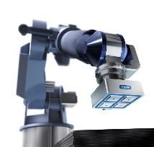
Grippers
Vacuum Gripper
Claw Gripper
Universal Gripper
Magnetic Gripper

Slide 7
ACCOMPLISHMENTS
Project Charter – Completed
Team Structure – Defined
Team Work Area – Setup
GitHub and LeanKit – Integrated

Slide 8
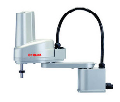
Carry Over
Design Research

Slide 9
Burndown Chart

